Slide 1
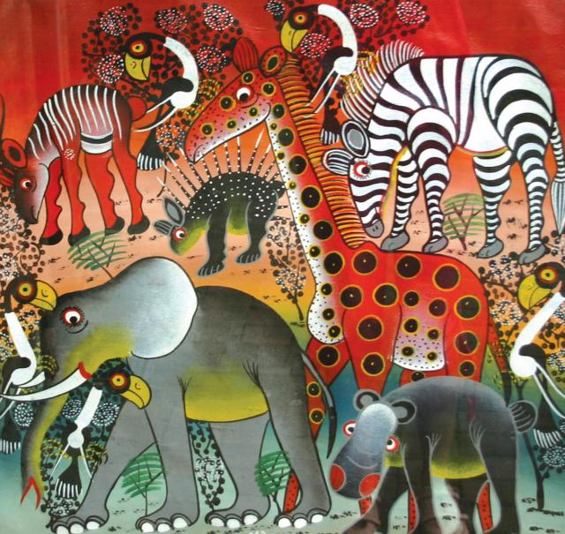
TINGA TINGA paintings
Once there was a man called Eduardo S. Tingatinga. He was born in Mozambique, but during the 1960s he established an art form that became associated with his new homeland, Tanzania. Today, "Tingatinga" is the Tanzanian term for this form of art, known mostly in Tanzania, Kenya, Norway, Sweden, Finland, and Denmark.

Slide 2
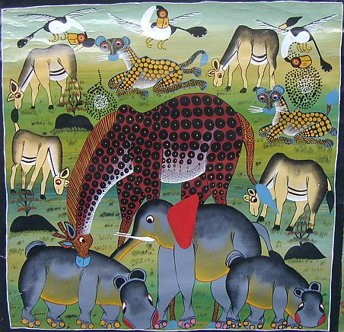

Slide 3
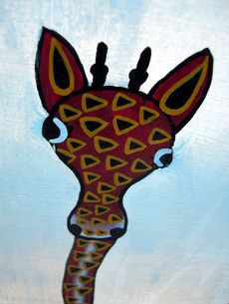
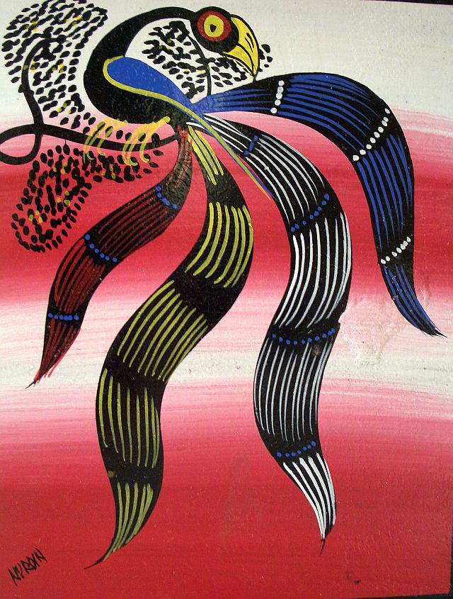
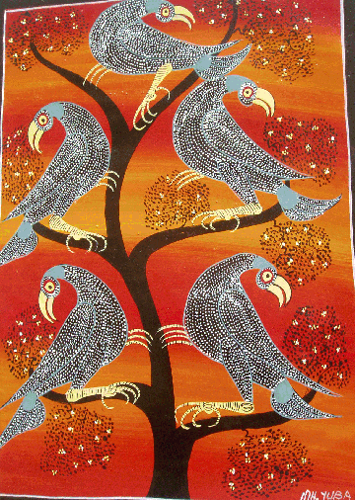
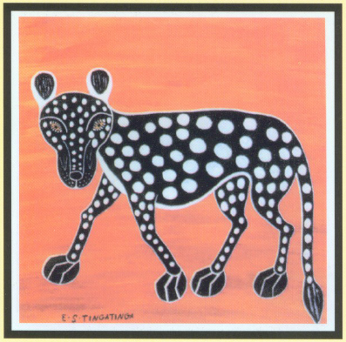
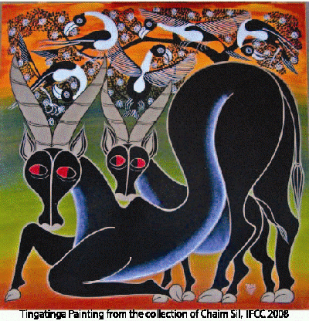

Slide 4
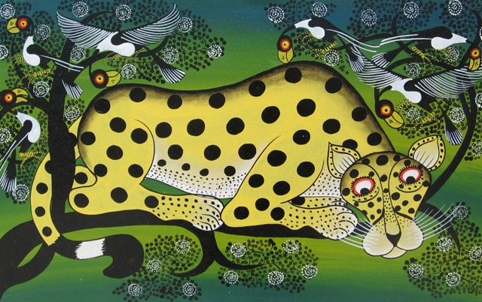

Slide 5
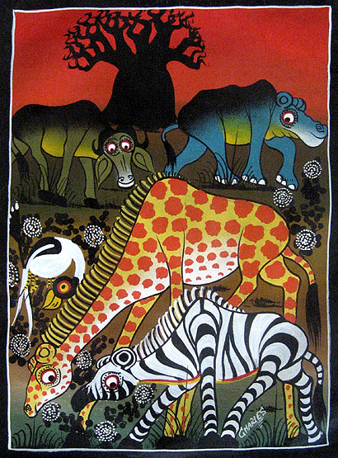
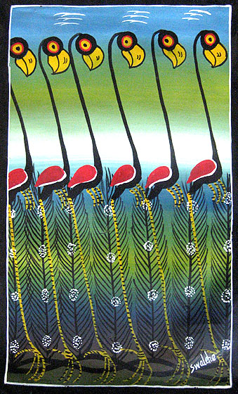

Slide 6
