Slide 1
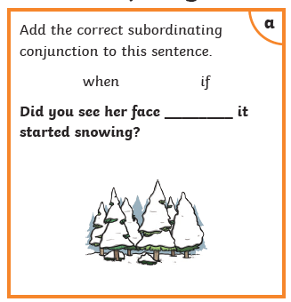
Thursday 21st January
Starter

Slide 2
Thursday 21st January

Slide 3
An adjective is a describing word.

Slide 4
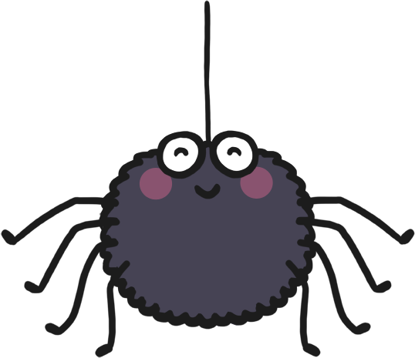
There was a spider in the bathroom.
+ adjectives =
There was a huge, hairy spider in the bathroom.

Slide 5
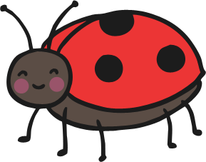
I found a ladybird on a leaf.
+ adjectives =
I found a tiny ladybird on a big leaf.

Slide 6
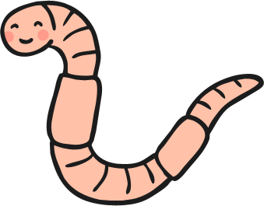
The worm dug through the soil.
+ adjectives =
The wiggly, pink worm dug through the soil.

Slide 7
Spot the adjectives.

Slide 8
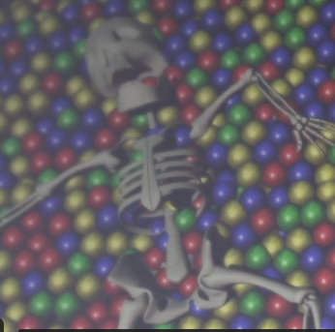
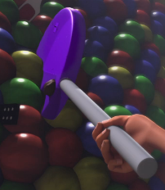
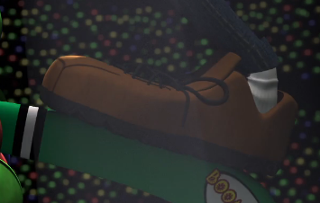
Use adjectives to describe what you can see.
Year 2 – Add 2 adjectives.
A _____________________ skeleton.
A _____________________ lollipop.
A _____________________ boot.

Slide 9
AND
We can use ‘and’ to show that there is more than one piece of information.
For example:
The scary skeleton and sticky lollipop.

Slide 10
Today we are going to use the conjunction
‘and’ to join 2 sentences together.
My example:
The disgusting, old plaster hung from the mountain and the multicoloured lollipop was stuck to my face.

Slide 11
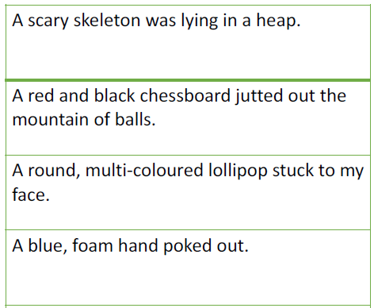
Independent task
Use the conjunction ‘and’ to join 2 of the sentences below.
Year 2
Use the conjunction ‘and’ to join 2 of your own sentences together.

