Slide 1
05.02.21

Slide 4
Circle the multiples of 10
120 13 30 80 23 204
2) Here are 20 cubes.
a) How many groups of 4 are there?
b) How many groups of 3 are there?
How many cubes will be remaining?

Slide 5
Circle the multiples of 10
120 13 30 80 23 204
2) Here are 20 cubes.
a) How many groups of 4 are there?
b) How many groups of 3 are there?
How many cubes will be remaining?
5
6
2

Slide 6
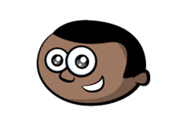
Mo has 9 lolly sticks.
He arranges his sticks to make triangles
Each triangle uses 3 sticks.
Mo can make 3 triangles with 9 sticks.
9 $=$ 3 groups of 3
9 $÷$ 3 $=$ 3

Slide 7
Mo has 9 lolly sticks.
What if Mo used his sticks to make squares?
Each square uses 4 sticks.
Mo can make 2 squares with 9 sticks.
There is one stick remaining.
9 $÷$ 4 $=$ 2 remainder 1

Slide 8
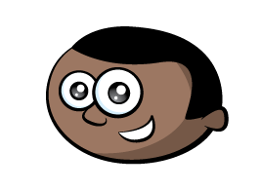
25 $÷$ 3 $=$
8 r 1
Have a think
$+$ 3
1
0
3
6
9
12
15
18
21
24
25
What’s the same? What’s different?
$−$ 3
0
1
4
7
10
13
16
19
22
25

Slide 9
25 $÷$ 4 $=$
6 r 1
Have a think
$+$ 4
1
0
4
8
12
16
20
24
25
$−$ 4
0
1
5
9
13
17
21
25

Slide 10
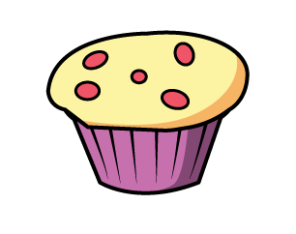
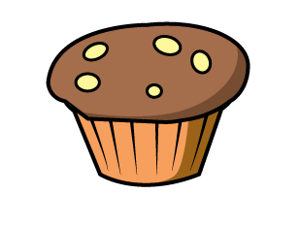
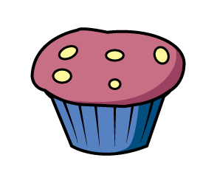
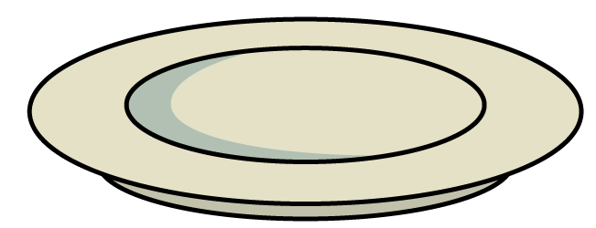
Here are 13 cakes.
They are shared equally between 4 plates.
There will be 3 cakes on each plate.
13 $÷$ 4 $=$ 3 r 1

Slide 11
13 $÷$ $=$6 r 1
2
13 $÷$ $=$ 2 r 3
5
Have a think

Slide 12
Year 4:
609 ÷ 3 =
2
0
3
H | T | O

Slide 13
576 ÷ 4 =
144
H | T | O
576
400
16
160
÷ 4
÷ 4
÷ 4
100
4
40

Slide 14
115 ÷ 5 =
23
H | T | O
115
100
15
÷ 5
÷ 5
20
3

Slide 15
765 ÷ 5 =
153
Have a think
67
2) 201 ÷ 3 =
H | T | O
H | T | O
201
765
500
15
180
21
250
÷ 3
÷ 5
÷ 3
÷ 5
÷ 5
100
3
60
50
7

Slide 16
638 ÷ 3 =
212 r 2
638
638
600
8
600
2
30
36
÷ 3
÷ 3
÷ 3
÷ 3
÷ 3
÷ 3
200
2 r 2
200
r 2
10
12

