Slide 1
5.1.2022
V.I.MMXXII
LO: To multiply and divide by 10/100/1000.

Slide 2
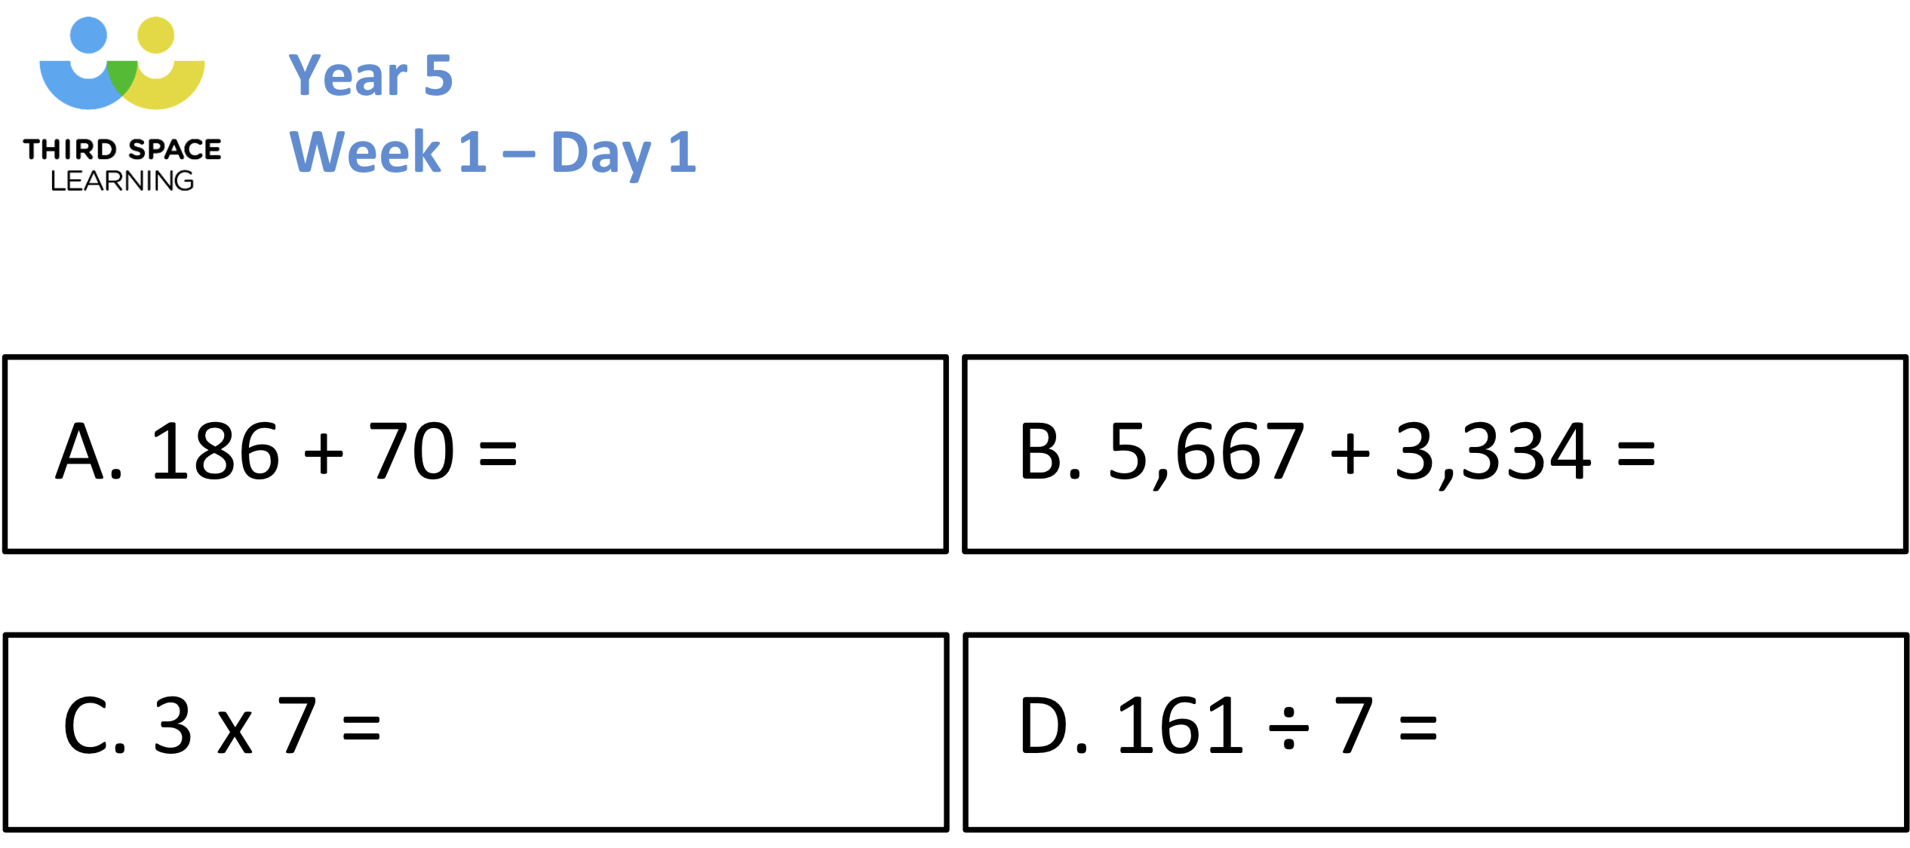

Slide 4
Th | H | T | O
7
8
Th | H | T | O
78 × 10 =
780
7
8
0
Th | H | T | O
78 × 100 =
7,800
7
8
0
0
TTh | Th | H | T | O
78 × 1,000 =
78,000
7
8
0
0
0
What stays the same? What changes?

Slide 5
1) To multiply a number by 10 each digit moves
to the left on a place value grid.
1
2) To multiply a number by 100 each digit moves
to the left on a place value grid.
2
3) To multiply a number by 1,000 each digit moves
to the left on a place value grid.
3

Slide 6
× 1,000 = 52,000
52
What number, when it is made 1,000 times greater, is equal to 52,000?
TTh | Th | H | T | O
5
2
0
0
0
171
1) 1,000 × = 171,000
41 × 10 × 10 × 10 =
2) 792 × 1,000 =
792,000
41 × 1,000 =
41,000
3) 10 × 41 × 10 × 10 =

Slide 7
TTh | Th | H | T | O
4
7
0
0
0
47,000 ÷ 10 =
4,700
TTh | Th | H | T | O
4
7
0
0
47,000 ÷ 100 =
470
TTh | Th | H | T | O
4
7
0
47,000 ÷ 1,000 =
47
TTh | Th | H | T | O
4
7
What stays the same? What changes?

Slide 8
1) To divide a number by 10 each digit moves
to the right on a place value grid.
1
2) To divide a number by 100 each digit moves
to the right on a place value grid.
2
3) To divide a number by 1,000 each digit moves
to the right on a place value grid.
3

Slide 9
Number | Divided by 10 | Divided by 100 | Divided by 1,000
35,000
 |  |  | 27
3,500
350
35
27,000
2,700
270
27,000
_____ ÷ 1,000 = 27
27 is one thousandth of what number?
TTh | Th | H | T | O
2
7
0
0
0

Slide 10
6.1.2022
VI.I.MMXXII
LO: To convert between kilometres and metres.

Slide 11
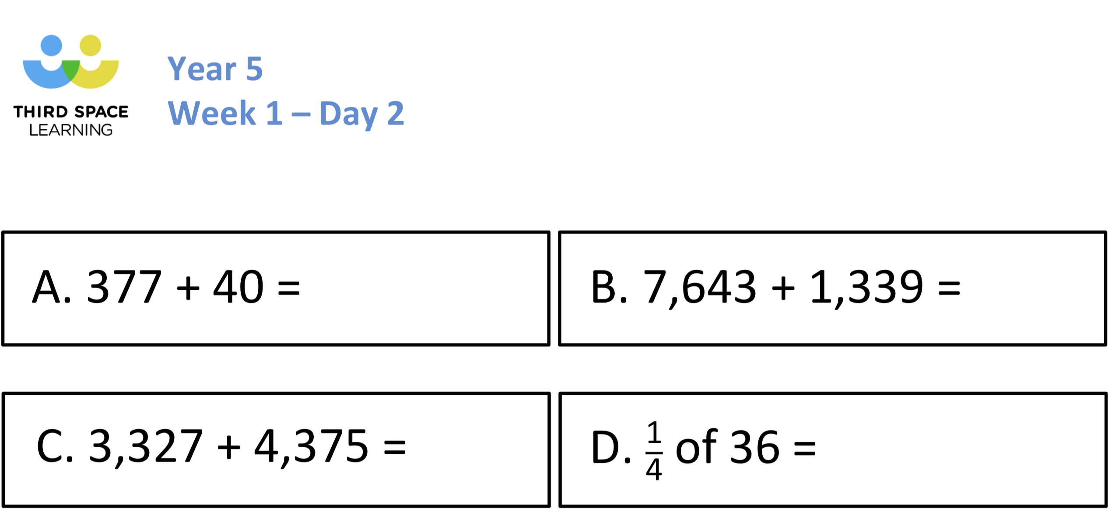

Slide 12
Sort the lengths into matching pairs.
Then explain how you matched the pairs.
730cm
360mm
7.3m
3,600m
3.6km
730mm
36cm
73cm
Y5

Slide 13
730cm
360mm
7.3m
36cm
3,600m
730mm
3.6km
73cm
Y5

Slide 14
Conversation Rules
I know that there are 10mm in 1cm, so to convert from mm to cm I divide by 10 and from cm to mm I multiply by 10.
I know that there are 100cm in 1m, so to convert from cm to m I divide by 100 and from m to cm I multiply by 100.
I know that there are 1000m in 1 km, so to convert from m to km I divide by 1000 and from km to m I multiply by 1000.

Slide 16
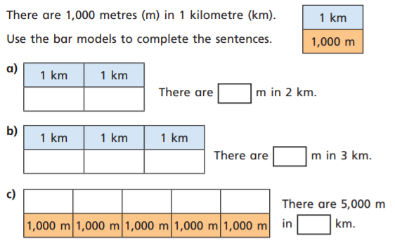

Slide 17
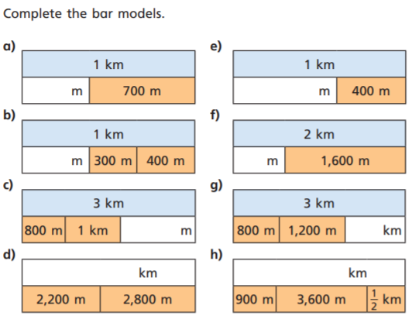

Slide 18
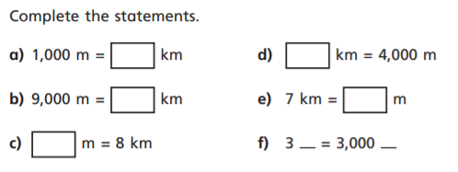

Slide 19
Varied Fluency 1
Match up the equal distances.
10,500m |  | 4,500m
7km |  | 8km
8,000m |  | 7,000m
4 km |  | 10 km
1
2
1
2
Y4

Slide 20
Varied Fluency 1
Match up the equal distances.
10,500m |  | 4,500m
7km |  | 8km
8,000m |  | 7,000m
4 km |  | 10 km
1
2
1
2
Y4

Slide 21
Varied Fluency 2
True or false?
4 km > 4,000m
1
2
Y4

Slide 22
Varied Fluency 2
True or false?
4 km > 4,000m
True, 4,000m is smaller than 4,500m.
1
2
Y4

Slide 23
Varied Fluency 3
Which is the odd one out?
3,500m
3 km
4,000m
1
2
4 km
4,500m
1
2
Y4

Slide 24
Varied Fluency 3
Which is the odd one out?
3,500m
3 km
4,000m
1
2
4 km
4,500m
1
2
Y4

Slide 25
Varied Fluency 4
Complete the part whole model.
8,500m
3 km
_____ m
1
2
Y4

Slide 26
Varied Fluency 4
Complete the part whole model.
8,500m
3 km
5,000 m
1
2
Y4

Slide 27
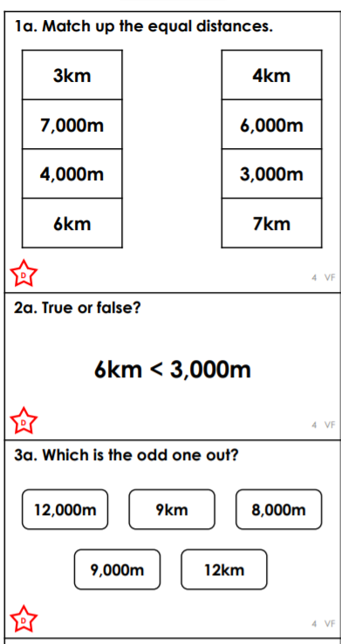
Fluency

Slide 28
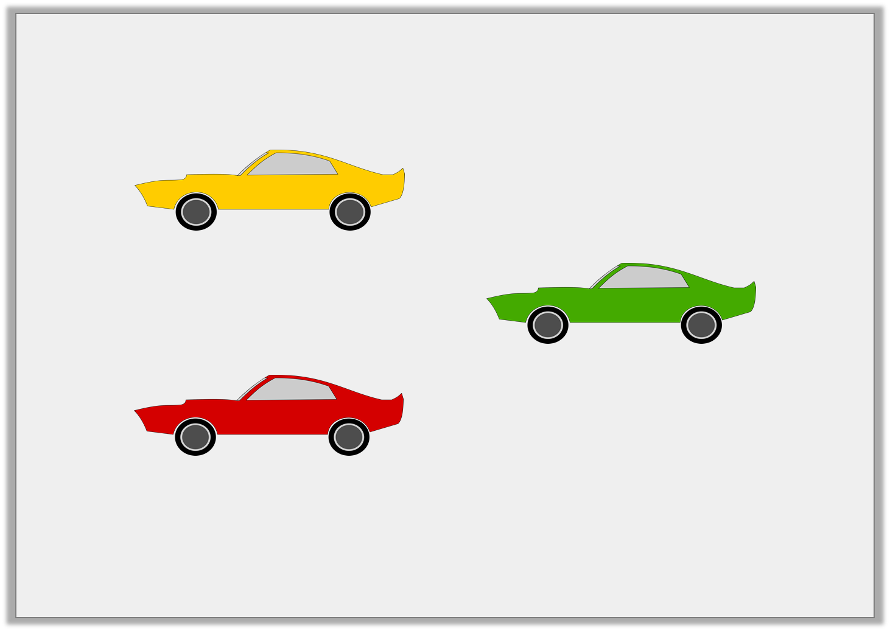
Problem Solving 1
Damon’s garage is 40m long. What combination of cars could he fit inside?
9.5m
600cm
450cm
Y5

Slide 29
Problem Solving 1
Damon’s garage is 40m long. What combination of cars could he fit inside?
Various possible answers where the total equals 40m or less, for example: 2 yellow cars, 2 green cars and 2 red cars = 9.5m + 9.5m + 600cm + 600cm + 450cm + 450cm = 40m
9.5m
600cm
450cm
Y5

Slide 30
7.1.2022
VII.I.MMXXII
LO: To convert between kilometres and metres.

Slide 32
kilometres
0
1
2
3
4
5
6
7
8
9
10
0
1,000
2,000
3,000
4,000
5,000
6,000
7,000
8,000
9,000
10,000
metres
10 km = 10,000 m
5 km = 5,000 m
6 km = 6,000 m
7 km = 7,000 m
8 km = 8,000 m
9 km = 9,000 m
1 km = 1,000 m
2 km = 2,000 m
3 km = 3,000 m
4 km = 4,000 m
0 km = 0 m

Slide 33
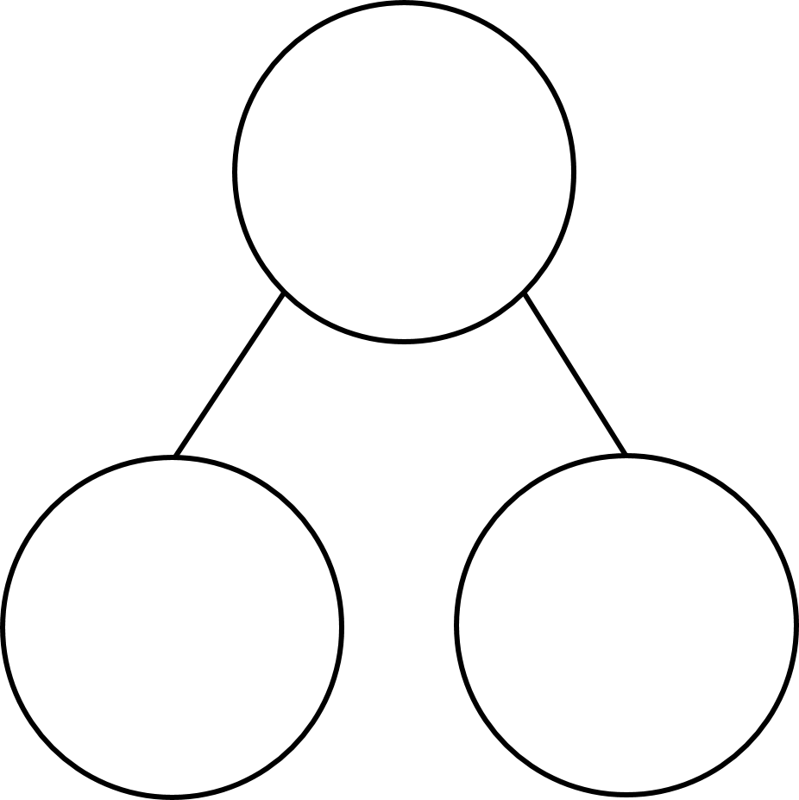
4,250
4 km 250 m
4,200
4 km 200 m
4,150
4 km 150 m
4,100
4 km 100 m
4,050
4 km 50 m
4,100 m
4,050 m
m
4,000
4 km
km and m
4 km
100 m
4,000 m
50 m

Slide 34
1 km = 1,000 m
800 m
1,000 $−$ 800 =
200
1 km
2 km = 2,000 m
600 $+$ 200 $=$
800
200 m
2,000 $−$ 800 =
1,200
2 km
600 m | 200 m
1,200 m

Slide 35
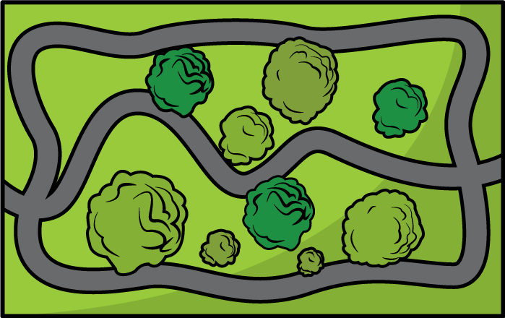
1 km
1$\frac{1}{2}$ km
2 km
$\frac{1}{2}$ km
2$\frac{1}{2}$ km
0 km
START
3 km
5 km
END
4$\frac{1}{2}$ km
4 km
3$\frac{1}{2}$ km

Slide 36
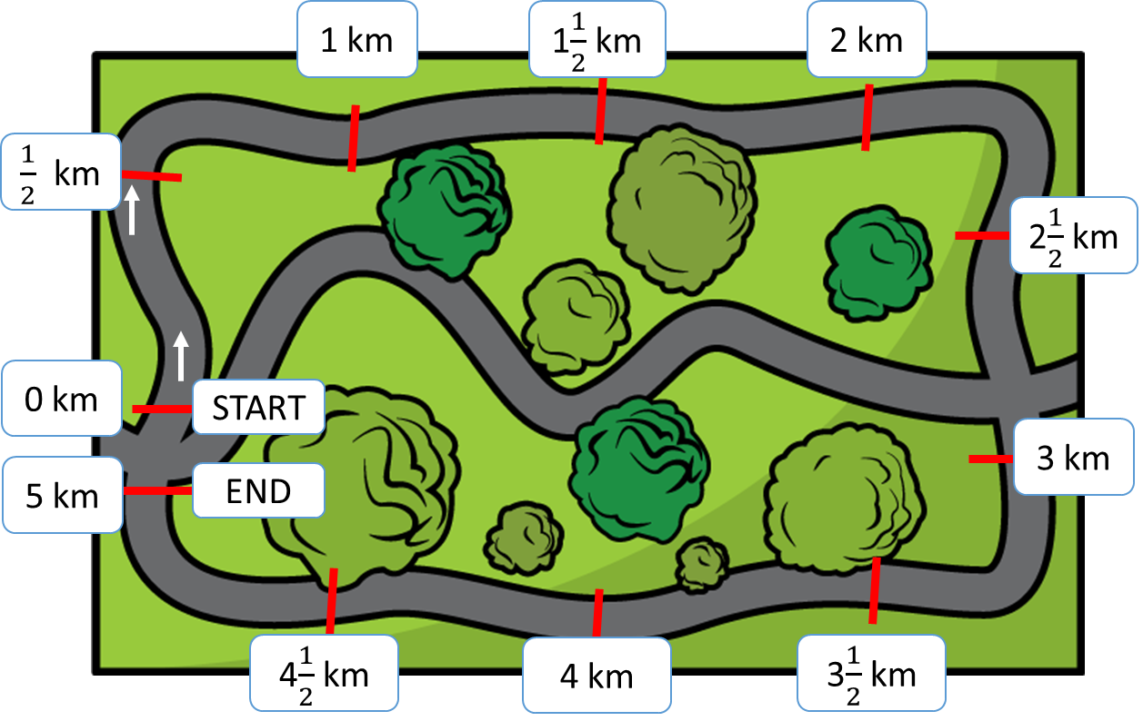
4 $\frac{1}{2}$ km
4,500 m
4,000 m
$\frac{1}{2}$ km
4 km
500 m
Annie has run 4 $\frac{1}{2}$ kilometres.
How many metres has she run?
4,500 m
$\frac{1}{2}$ of 1 km $=$
$\frac{1}{2}$ of 1,000 m $=$
1,000 m $÷$ 2 $=$
500 m

Slide 37
5,000 m
5 km
2$\frac{1}{4}$ km
?
2,250 m
2,750 m
Teddy has run 2 $\frac{1}{4}$ km.
How many metres does he have left to run?
2,000 m
2,250 m
2,500 m
2,750 m
3,000 m
5,000 $−$ 2,250 $=$
2,750
1,000 $÷$ 4 $=$
250
Teddy has 2,750 metres left to run.
2 km
2$\frac{1}{4}$ km
2$\frac{1}{2}$ km
2$\frac{3}{4}$ km
3 km

