Slide 1
Ways we can help AT crudgington primary school

Slide 2
Early Help
At Crudgington Primary School, we understand that family life can sometimes be difficult and challenging. From time to time there may be situations where you feel you need more help and support. At these times we are able to offer you what is known as the Early Help Offer.
Providing early help to our children and families, means we can be more effective in preventing problems, from affecting children’s ability to thrive and learn. Early help means providing support as soon as a concern emerges, at any point of a child’s life, from Reception through to Year 6.
Please see the information below for details of the range of ways in which can help you to find the support that you need.

Slide 3
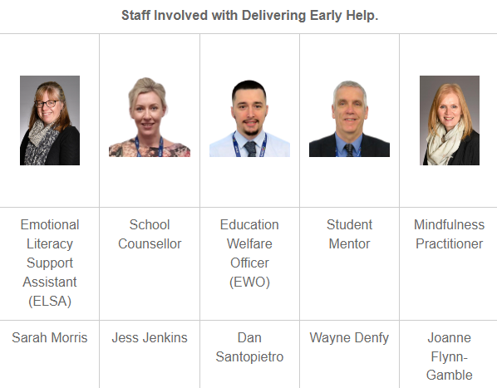
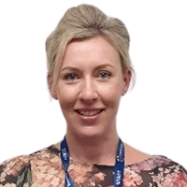
Staff involved with delivering Early Help

Slide 4
The ways we listen
We can be a professional friend and offer support:
Offering a helping hand
Maintain a supportive relationship
Friendly advice
Judgement free listening ear
How we gather views and are alert to potential issues:
Parent/carer questionnaires
Pupil voice – student council
Wishes and worries boxes
Safety squad

Slide 5
School attendance
If you need support with your child’s attendance or are facing any barriers in getting your child to school, we can support you. Please contact the school and ask to meet with our friendly Educational Welfare Officer (EWO) Dan Santopietro. He is happy to meet with you at home or at school.
Should I keep my child off school checklist poster Shoud I keep my child off school checklist poster (publishing.service.gov.uk)

Slide 6
Emotional Literacy Support Assistant (ELSA)
If your child has anxiety regarding school or any aspect of their wider life. We have an Emotional Literacy Support Assistant, Mrs Morris, who works with individuals and small groups of children to support them with managing feelings and emotions. https://www.elsanetwork.org/

Slide 7
School Counsellor
Our school counsellor is Jessica Jenkins. She works one day a week in school with us supporting children through a range of needs. She is highly experienced in role and delivers exceptional outcomes.

Slide 8
Community fridge
Open from 8.30am to 4pm, Monday to Friday, with a simple message: “Take what you want . . . donate if you can.”
We are passionate about providing a service to our local community wherever we can.
The community fridge – where everything is free – includes fresh milk, bread, fruit and vegetables, plus cereals, potatoes, pasta, tinned meals, and a variety of washing and cleaning products.
Located at Wrekin View Primary School

Slide 9
Uniform
Do you need support with uniform?
Our uniform at crudgington primary school
At Crudgington Primary School we have second hand uniform available with The Friends team. Please contact them on their Facebook page or speak to them on the playground. We also have a small selection in the school office.
If you can’t find what you need please speak to the office and they will support you with what you might need.

Slide 10
Young carer
Is your child a young carer? If so we can support with a range of clubs and activities to complement the work of the Young Carers Association
Telford & Wrekin Young Carers Service | Telford CVS (telfordandwrekincvs.org.uk)
Young Carers Service is a commissioned service of Telford & Wrekin Council. The service offers:​
One-to-one support for those who need it most
Term-time Youth Club
Holiday and half-term activities, trips and events
School drop-ins
Individual befriending support
Information and advice for the whole family
Regular newsletter with news, events and helpful advice

Slide 11
BEAM – wellbeing drop in service
https://www.childrenssociety.org.uk/information/young-people/well-being/services/beam-shropshire-telford-wrekin
We are an emotional health and wellbeing drop-in service for young people under 25 years old who are registered with a GP in Shropshire, Telford or Wrekin
BEAM can...
recommend strategies and techniques that aim to make life easier – for example, how to manage a panic attack, or how to improve sleep.
give practical suggestions and advice – this might be suggesting you look at website or that you contact another service.
provide a listening ear if you have something you want to get off your chest.
BEAM won't...
assess or diagnose any conditions.
automatically make referrals into other services.
necessarily have to tell anyone that you have spoken to Beam.

Slide 12
Sleep
Routines, boundaries, sleep, listening , co-parenting, anxiety...
Do you need some tips or support with parenting? Place2be have developed a range of short videos to help parents navigate the world of being a parent! Click on the Place2Be Parenting Smart link to explore the videos.
https://parentingsmart.place2be.org.uk/
Does your child find it hard to settle at bedtime, or won't go to sleep without you, or wakes in the night? Supported by Beam and The Children's Society, we have put together some top tips to help with sleep.
Keep fixed morning routines, try not to allow too late a lie in at weekends. A regular sleep/wake cycle helps maintain structure
Avoid napping in the day
Exercise more in the day as this promotes cardiovascular health and creates dopamine in the brain which aids sleep later in the day
Take warm baths at night
Do gentle stretches before bed
Read a book before sleeping, write a to do list before bed
Avoid smartphones or devices up to one hour before bed
Make the room a relaxing place to be- avoid having a TV in the bedroom or other devices which emit a blue light
Set the temperature to 18-24 degrees

Slide 13
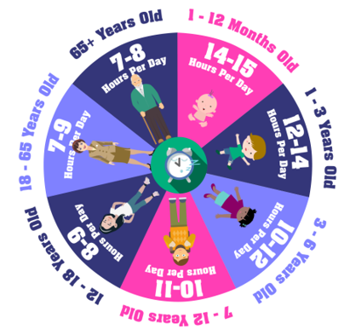
Sleep – part 2
How much sleep?
This chart comes from The Sleep Council as a guide to amount of sleep and ages. It’s important to note that the hours on the chart are a guide and it’s important to focus on sleep quality and establish a good routine. Just like adults, come children need more sleep and some children need less sleep.
National Sleep Helpline 03303 530 541

Slide 14
Sleep routine
Having a regular routine is one of the best ways to train our bodies to sleep well: children, teens and adults. This means going to bed and getting up at the same time (or as close to it as possible) everyday, even at weekends.
This isn’t something that will work for everyone - there has to be adjustments for those working night shift patterns. But where you can, lead by example.
A bedtime routine is a set of activities that occur every night at the same time in the same order.
An example of a routine is:
One hour before bed, turn off the T.V and other electronic devices and have ‘calm time’ e.g. colouring, drawing, playing with toys
Have a drink and a snack (avoid caffeine)
Up to bathroom for bath/wash, teeth and toilet
Bedroom for story/massage/music
This is just an example of a bedtime routine - plan to include things that your child finds calming. The length of your routine will depend on your child. Ideally it would take 30 minutes but sometimes can be up to an hour.
Limit screen time
This is something you have no doubt heard before. Children and young people are more likely to delay sleep if they are caught up playing a video game, watching TV, or chatting to their friends. They are more likely to have their brains stimulated by this content, which makes it harder to sleep. This is because just 10 minutes of blue light exposure interferes with the brain’s production of the ‘sleepy’ hormone, melatonin. The Sleep Council’s ‘Good Night Guide for Children’, recommends turning off all screens off at least one hour before bedtime. The Good Night Guide for Children.pdf (betterhealthatworkaward.org.uk)

Slide 15
Housing
Click on the links below for support with housing and the cost of living
https://www.telford.gov.uk/costofliving
https://www.telford.gov.uk/info/20667/tenant
https://www.telford.gov.uk/info/20667/tenant_support/6580/damp_and_mould
https://www.telford.gov.uk/info/20806/affordable_warmth
https://www.telford.gov.uk/info/20667/tenant_support/6577/useful_telephone_numbers_and_links

Slide 16
Does your child have Special Educational Needs?
SEND coffee mornings – write the information for this
Strengthening Families - SEND - Local offer (telfordsend.org.uk)
The most useful children and family support is that which helps families to stabilise and improve their own situation through primary prevention approaches at the earliest time. Strengthening Families provide local services for families with children aged 0-19 through children and family centres, in a planned approach to ensure resources are targeted where they are most effective.
Home - PODS (podstelford.org)
PARENTS OPENING DOORS (PODS)
We work across the whole range of services including health, education, social care, and alongside our voluntary sector partners – at a local, regional and national level.

Slide 17
Does your child have Special Educational Needs? continued
Telford SENDIASS | SENDIASS Telford
Listen to your concerns and provide information and advice on the 'phone or in person
Work with you to explore your options
Help you prepare for meetings
Help to explain reports written by professionals
Give you information in relation to SEND law to enable you to participate and make informed decisions regarding your child's education
Signpost you to other sources of information and support
Work in partnership with schools and the local authority to develop positive relationships and outcomes

Slide 18
Practical support
Wrap around care – This can be booked through Sarah Bennett. We offer breakfast club from 8:00am and wrap around until 6:00pm.

Slide 19
Sign posting to other agencies
Family connect - Family Connect (familyconnecttelford.co.uk) Family Connect is a free, confidential service providing, impartial advice, information, guidance and support on a full range of children's services available across the borough including childcare, activities, school admissions and finance.
School nurse Telford School Nurses (shropscommunityhealth.nhs.uk)
Mental health support Mental health help services - Mental health help services - Telford & Wrekin Council
Crisis support Telford Crisis Support – Volunteer led since 2013
Health visitor Health visiting service (shropscommunityhealth.nhs.uk)
Strengthening families Strengthening Families - SEND - Local offer (telfordsend.org.uk)
Citizens advice Home Page | Citizens Advice Telford and the Wrekin
Housing Housing association - Telford & Wrekin Council
Domestic Abuse support Domestic abuse - Telford & Wrekin Council

Slide 20
Sign posting to other agencies continued
CAP (Christians against Poverty) - Home | CAP UK
Thrive - Inspire2Thrive | Telford & Wrekin | Inspire2Thrive | Telford
Women’s Aid – What is domestic abuse? - Women’s Aid (womensaid.org.uk)
Parent Education growth support (PEGS) is a social enterprise set up to support parents, carers and guardians who are experiencing Child to Parent Abuse (including those with adult offspring). We don’t directly work with the child displaying the behaviours but have a network of partners whose expertise lies in this area. https://www.pegsupport.co.uk/
Children’s Autism Hub - About Children's Autism Hub | Telford Autism Hub

